Slide 1
Basic Internship@Clevered AI App/ Adventure game
App User Manual
Author:Raphaël

Slide 2
Table of Contents
Acknowledgment
About me
My Intership

Slide 3
Acknowledgements
A small vote of thanks for all who have helped me in this journey of App Development – my parents, Clevered, Mentor, Group Members, Friends, Miss.Mani

Slide 4
About Me..
Student’s Introduction
Name:raphaël
Age:9
Libanon bikfaya

Slide 5
About My Internship with Clevered..
Easy enjoyit learn about snap

Slide 6
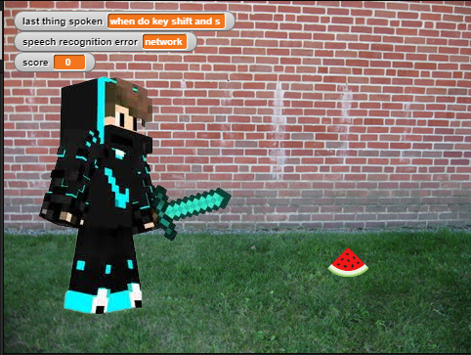
About App..
App’s Main Menu
App’s Introduction
Adventure game
Using speech recgnition

Slide 7
How do I use the App?
Press green flag to start
say move and jump to move and jump
collect the watermelon to increase the score

Slide 8
Option Name
(This will be repeated for each option of the App)
Internet Connection Must Be Good.
Mic should be proper/Good
Steps to use the same
Any special considerations/ dependencies/risks while using the option

Slide 9
Contact Person
Please reach out to student name at student’s email address for any questions/ concerns/ suggestions on the App

Slide 10
Thank you!

